Slide 1
Environment Setting
Computer Programming Languages for A.I. (PE5064)
Ph.D. Junetae, Kim
Assistant professor

Slide 2
Contents
Installing Anaconda
Installing Jupyter lab
Installing Pandas
Installing Numpy
https://www.anaconda.com/open-source

Slide 3
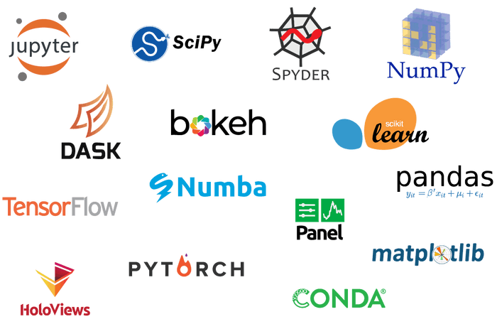
What is anaconda?
A set of packages for data science including Python
https://www.anaconda.com/open-source

Slide 4
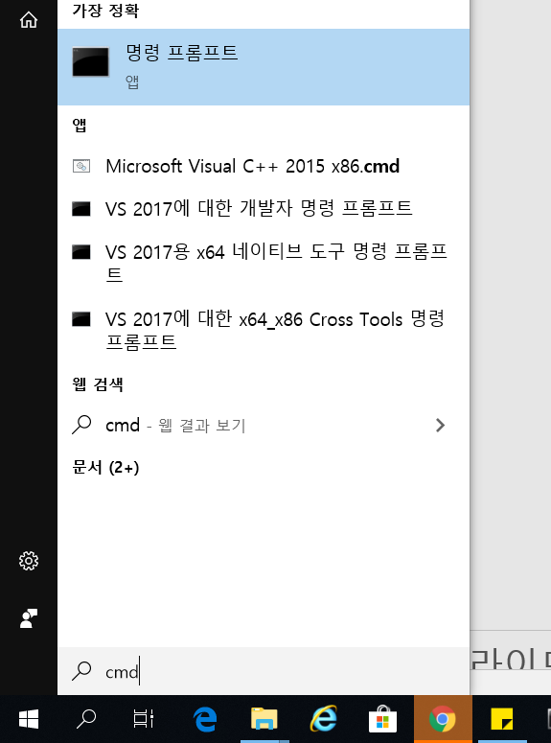
1. Installing Anaconda
(1) Checking computer ‘bit’ information
①Click the lower-left Start button to open the Start Menu,
②input cmd in the empty box and tap Command Prompt in the results.

Slide 5
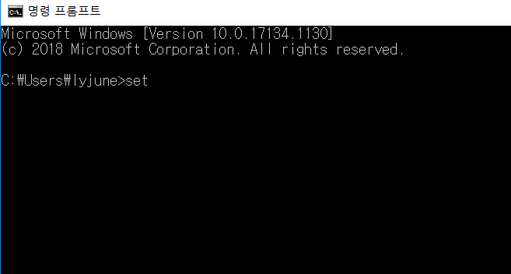
1. Installing Anaconda
(1) Checking computer ‘bit’ information
③ input set and press enter key

Slide 6
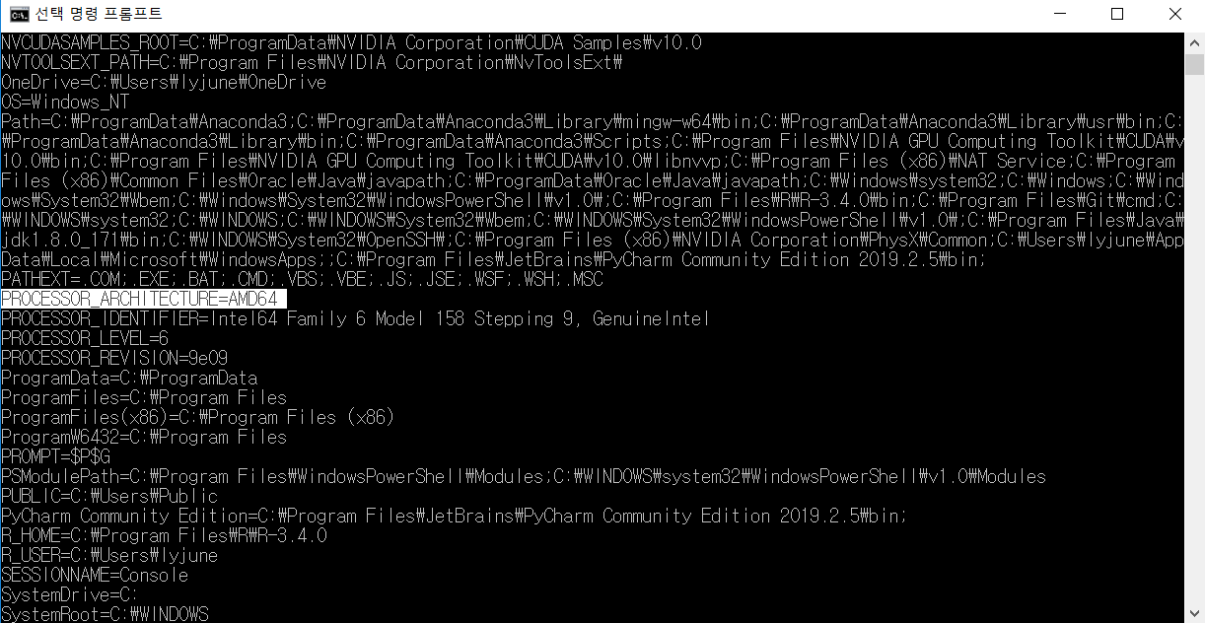
1. Installing Anaconda
(1) Checking computer ‘bit’ information
④ Check PROCESSOR_ARCHITECTURE=??

Slide 7

1. Installing Anaconda
(2) Downloading the anaconda installer
Input anaconda in Google search box.
Open the Web page - https://www.anaconda.com/

Slide 8

1. Installing Anaconda
(2) Downloading the anaconda installer
Click Products tab and Individual Edition menu

Slide 9
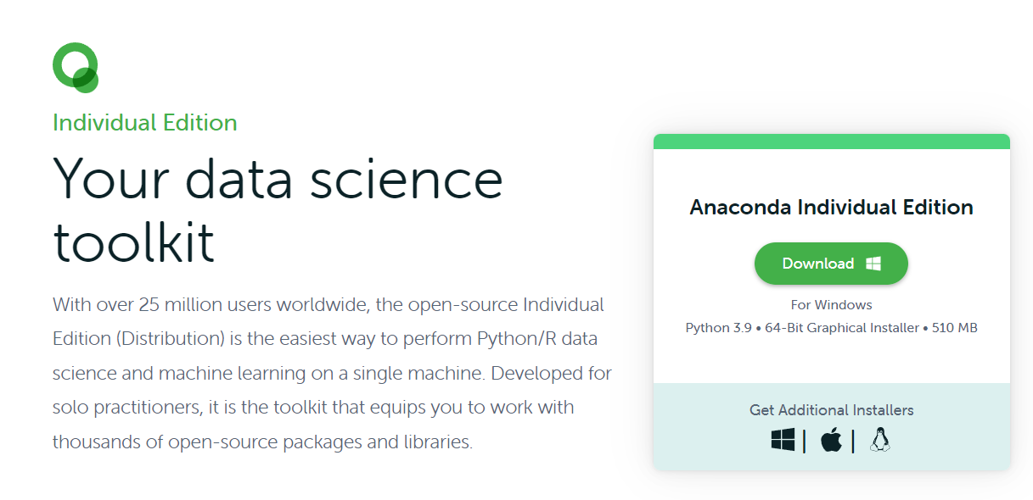
1. Installing Anaconda
(2) Downloading the anaconda installer
Click Get Additional Installers

Slide 10
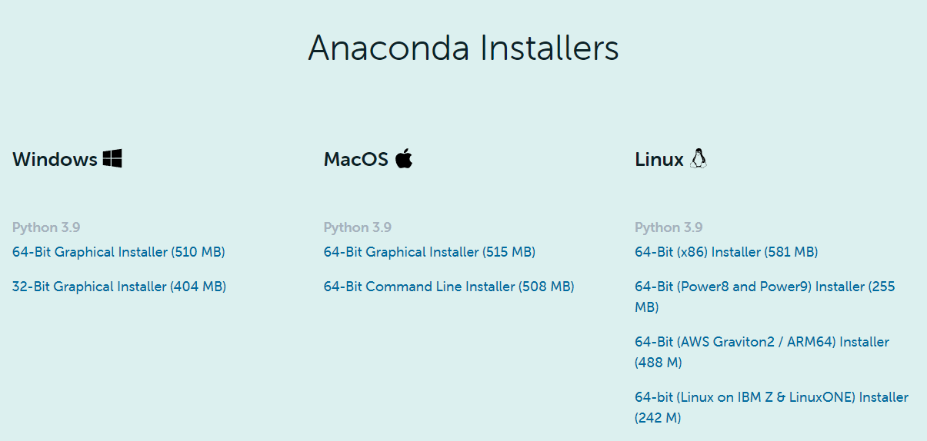
1. Installing Anaconda
(2) Downloading the python installer
Downloading Windows installer (64-bit) (pc bit version ==64)
Windows installer (32-bit) (pc bit version ==32)
64 bit
32 bit

Slide 11
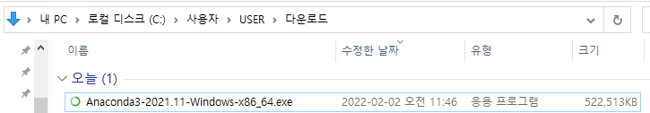
1. Installing Anaconda
(2) Installation
Execute the install file

Slide 12
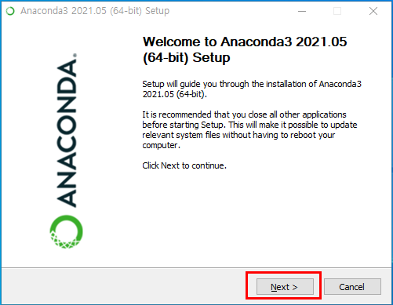
1. Installing Anaconda
(3) Installation

Slide 13
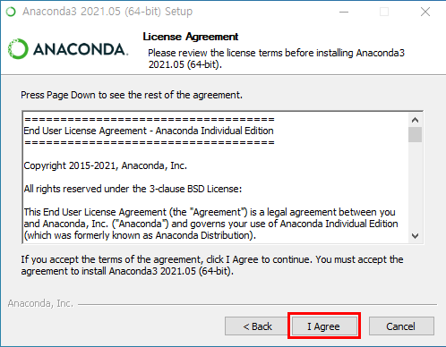
1. Installing Anaconda
(3) Installation

Slide 14
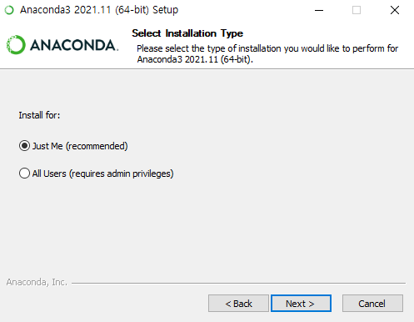
1. Installing Anaconda
(3) Installation

Slide 15
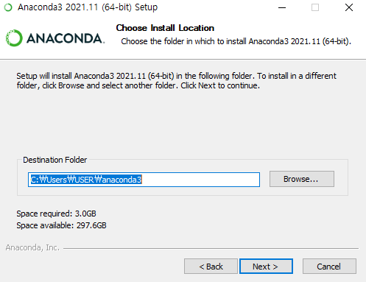
1. Installing Anaconda
(3) Installation

Slide 16
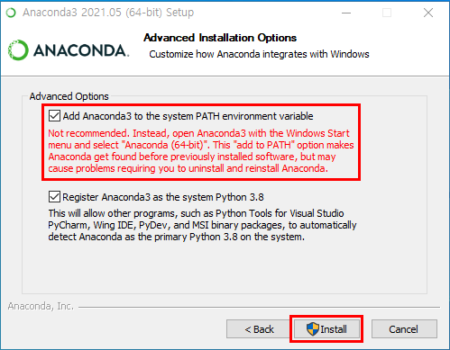
1. Installing Anaconda
(3) Installation

Slide 17
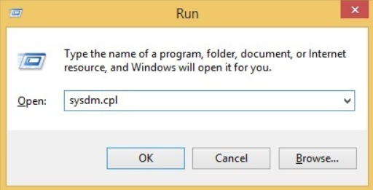
1. Installing Anaconda
(4) Checking whether Python is working or not
start the Run box and enter sysdm.cpl

Slide 18
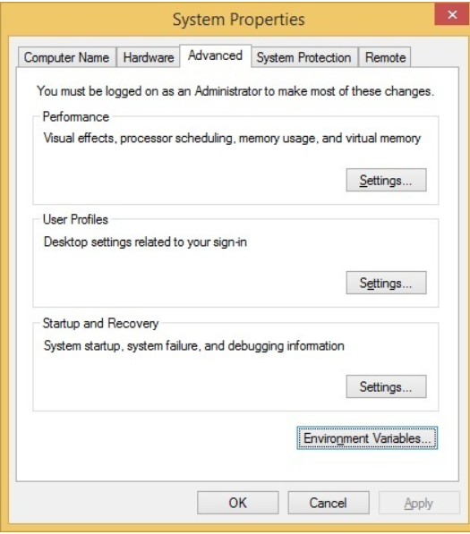
1. Installing Anaconda
(4) Checking whether Python is working or not
Go to the Advanced tab and click the Environment Variables button

Slide 19
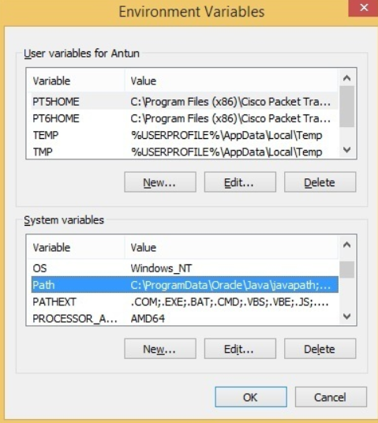
1. Installing Anaconda
(4) Checking whether Python is working or not
In the System variable/ User variables window, find the Path variable and click Edit
Or

Slide 20
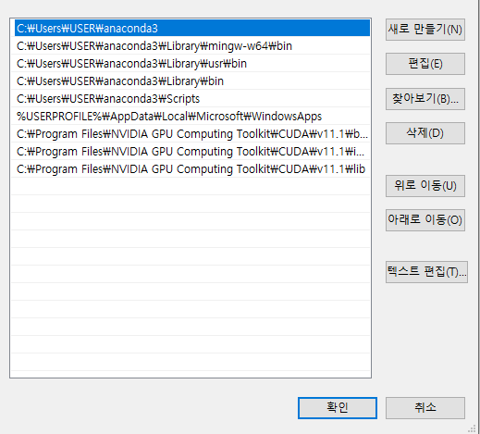
1. Installing Anaconda
(4) Checking whether Python is working or not
Check whether there several lines related to anaconda3

Slide 21
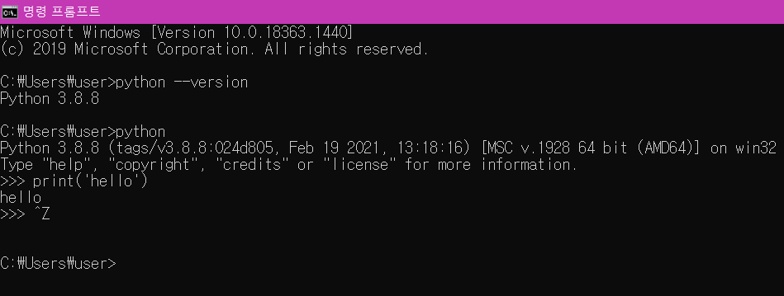
1. Installing Anaconda
(4) Checking whether Python is working or not
Input: python, press enter key
Input: print(‘hello’), press enter key
ctr + z to exit python

Slide 22
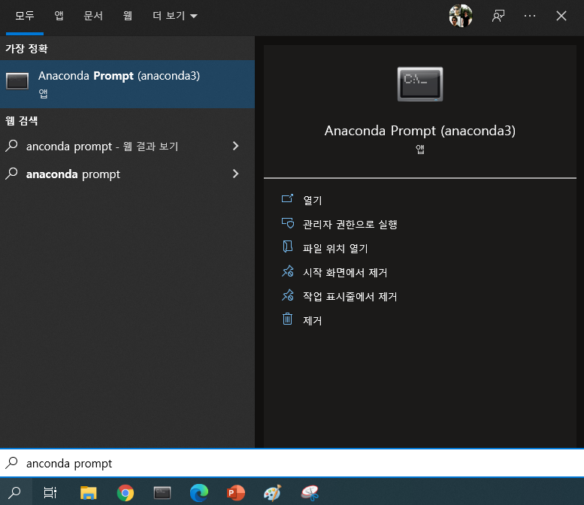
1. Installing Anaconda
(4) Creating virtual environment
Open Anaconda Prompt

Slide 23
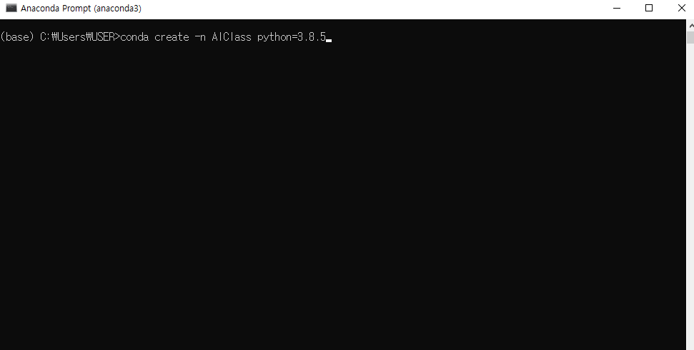
1. Installing Anaconda
(4) Creating virtual environment
Open Anaconda Prompt
Type: conda create -n <my_environment> python=<new_version>
conda create -n AIClass python=3.8.5

Slide 24
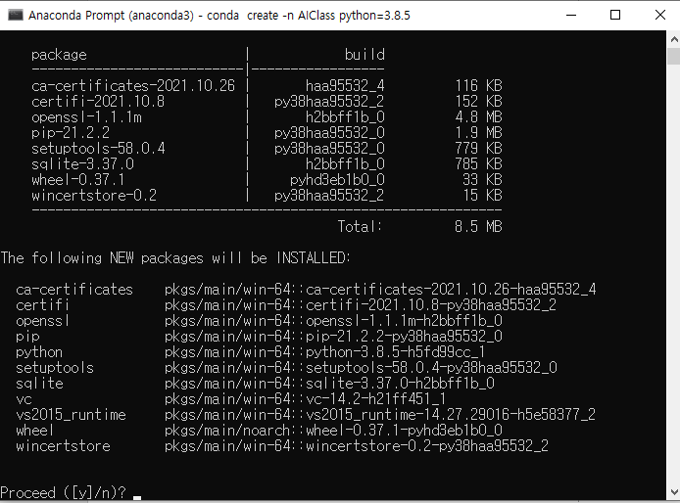
1. Installing Anaconda
(4) Creating virtual environment
Install related packages: Press y and enter key

Slide 25
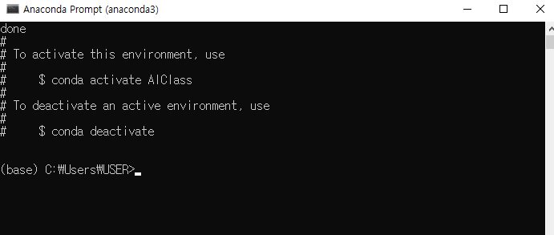
1. Installing Anaconda
(4) Creating virtual environment
Now, you have just created virtual environment named as ‘AIClass’

Slide 26
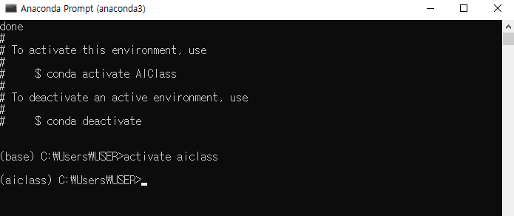
1. Installing Anaconda
(4) Creating virtual environment
You should activate the virtual environment before doing your python task
activate <your environment name>
Activate AIClass

Slide 27
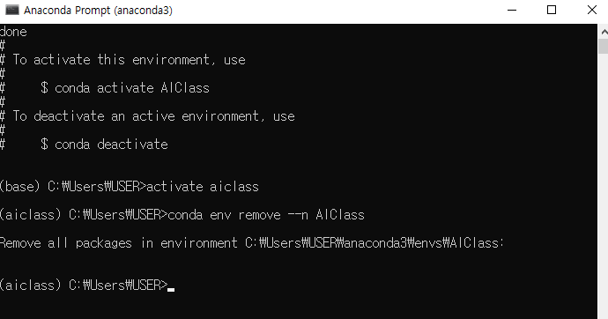
1. Installing Anaconda
(4) Removing virtual environment
Sometime you need to remove your environment for several reasons
conda env remove --n <your environment name>
conda env remove --n AIClass

Slide 28
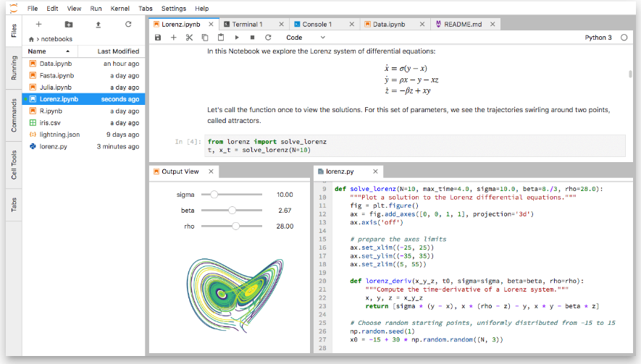
2. Installing Jupyter lab
(2) Jupyter lab installation
What is Jupyter lab?
It’s a convenient tool for python programming
It enables you to work with documents and activities such as Jupyter notebooks, text editors, terminals, and custom components in a flexible, integrated, and extensible manner.

Slide 29
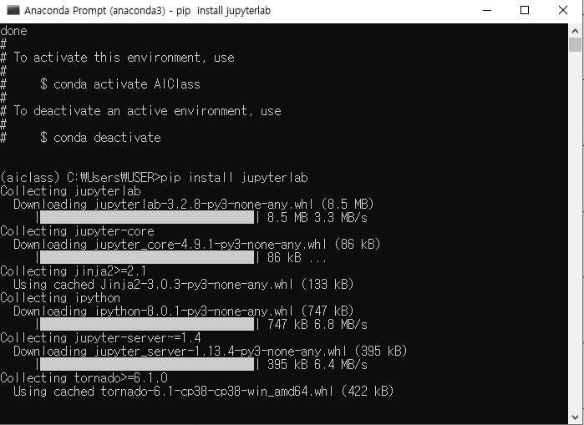
2. Installing Jupyter lab
(2) Jupyter lab installation
Open CMD, activate <your_enviorment >,
then input: pip install jupyterlab (no blank between two words)

Slide 30
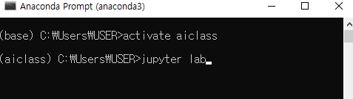
2. Installing Jupyter lab
(4) Run Jupyter lab
Open CMD, activate <your_enviorment >,
then input: jupyter lab (blank between two words!)

Slide 31
2. Installing Jupyter lab
(5) Set the chrome as default
English
https://support.google.com/chrome/answer/95417?co=GENIE.Platform%3DDesktop&hl=en
Korean
https://support.google.com/chrome/answer/95417?co=GENIE.Platform%3DDesktop&hl=ko

Slide 32
Break time

Slide 33
2. Installing Jupyter lab
(6) Introduction to Jupyter lab
②
①
③
Click

Slide 34
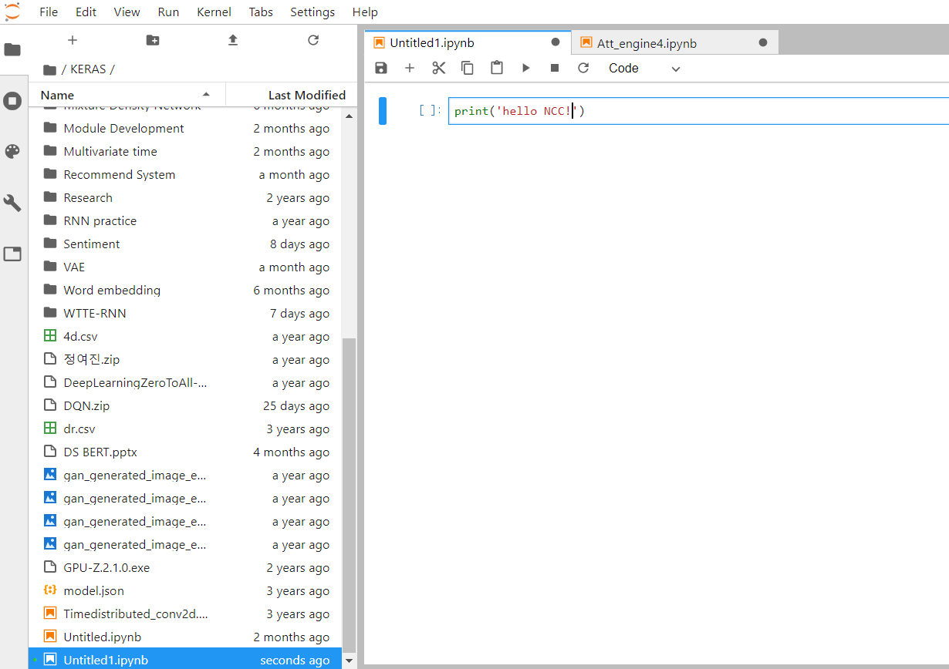
2. Installing Jupyter lab
(6) Introduction to Jupyter lab
Type it, then press ctrl + enter key

Slide 35
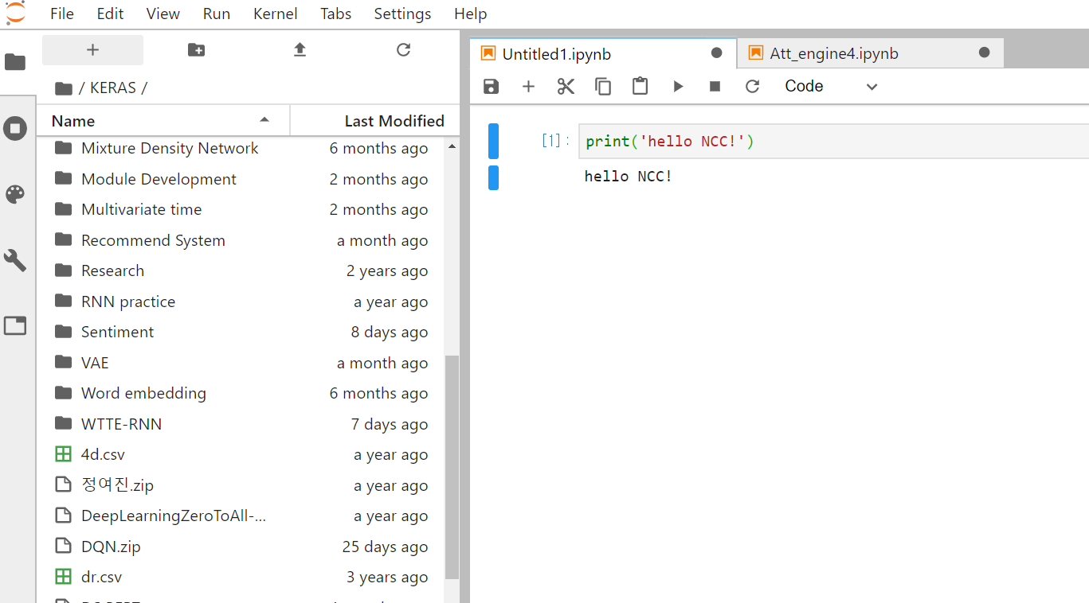
2. Installing Jupyter lab
(6) Introduction to Jupyter lab
Your Input
Return

Slide 36
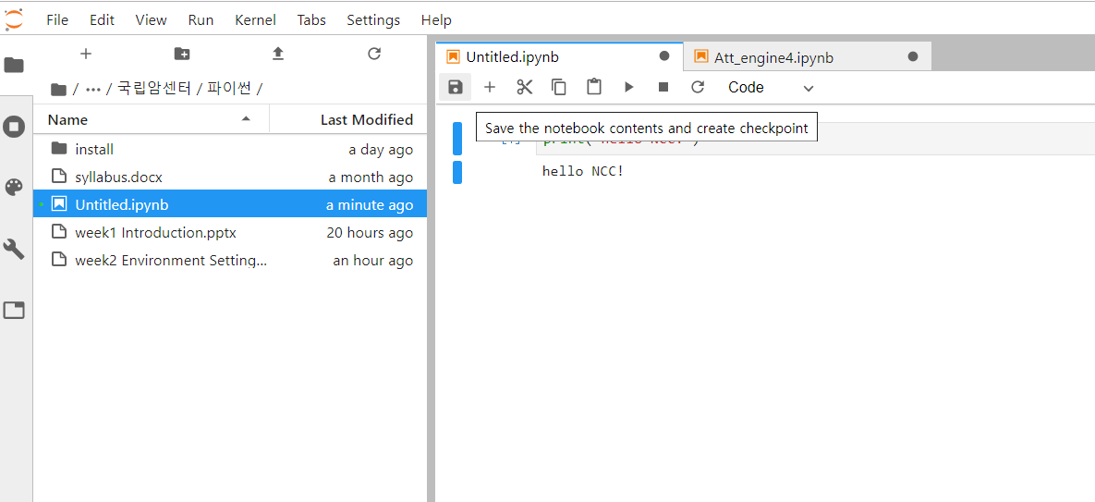
2. Installing Jupyter lab
(6) Introduction to Jupyter lab
Save

Slide 37
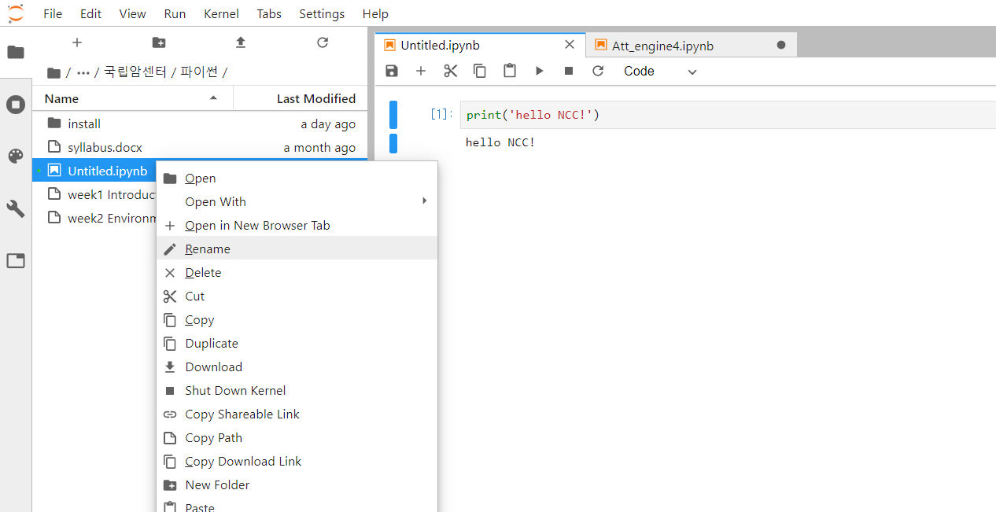
2. Installing Jupyter lab
(6) Introduction to Jupyter lab
Rename

Slide 38
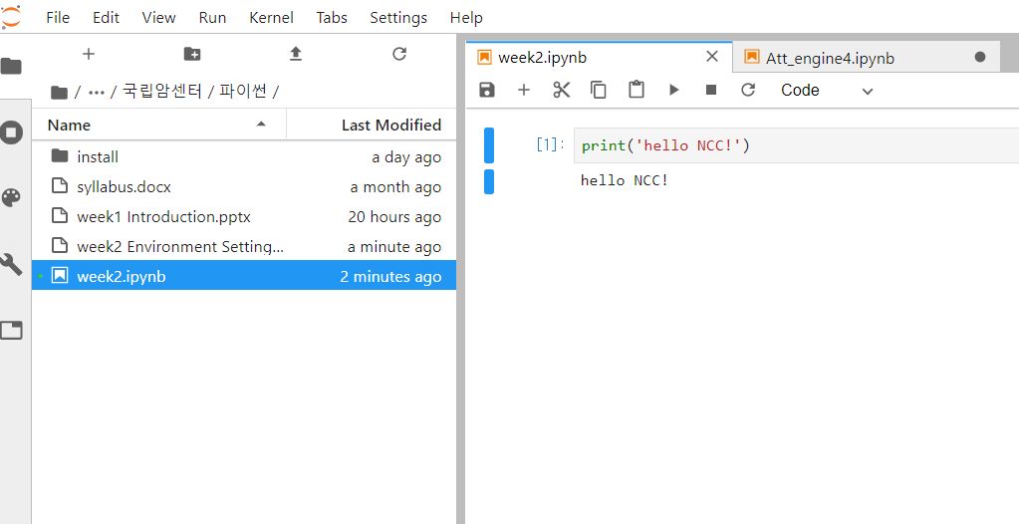
2. Installing Jupyter lab
(6) Introduction to Jupyter lab

Slide 39
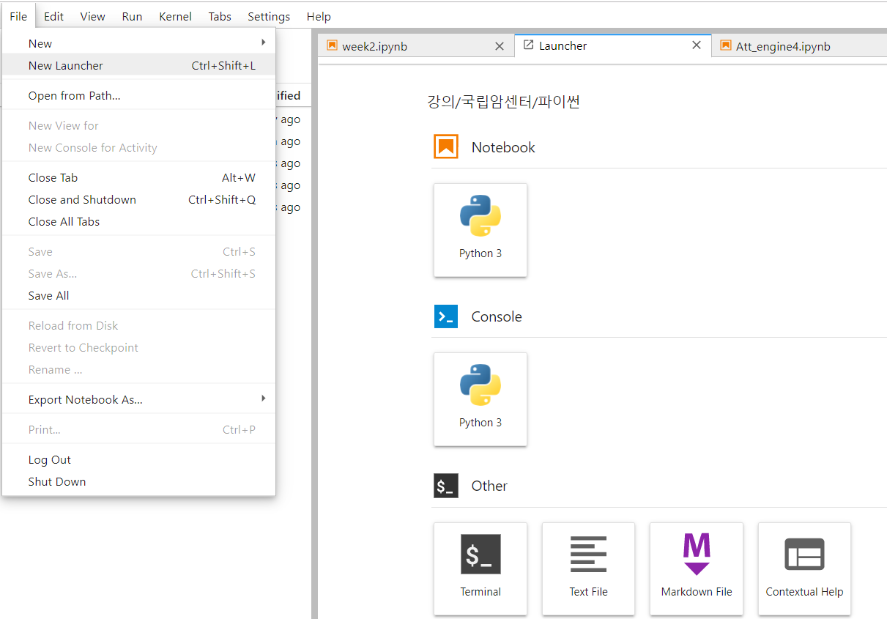
2. Installing Jupyter lab
(6) Introduction to Jupyter lab
①
②

Slide 40
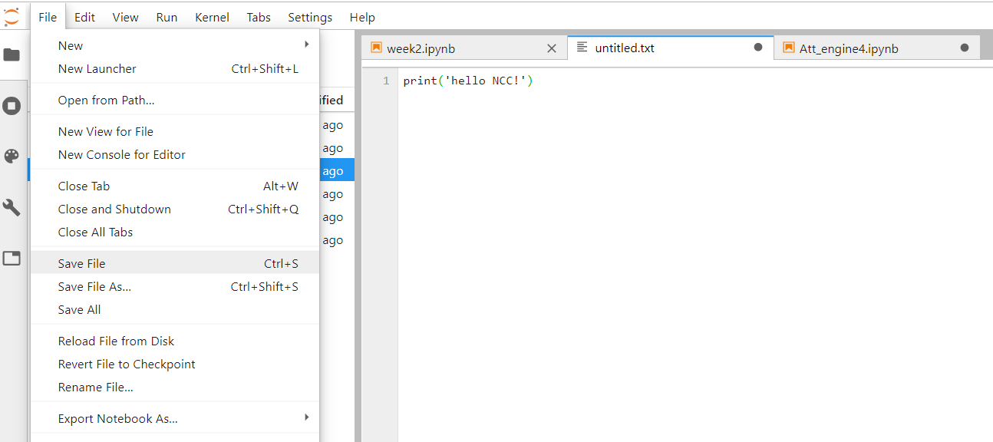
2. Installing Jupyter lab
(6) Introduction to Jupyter lab
① Type
② Save the file

Slide 41
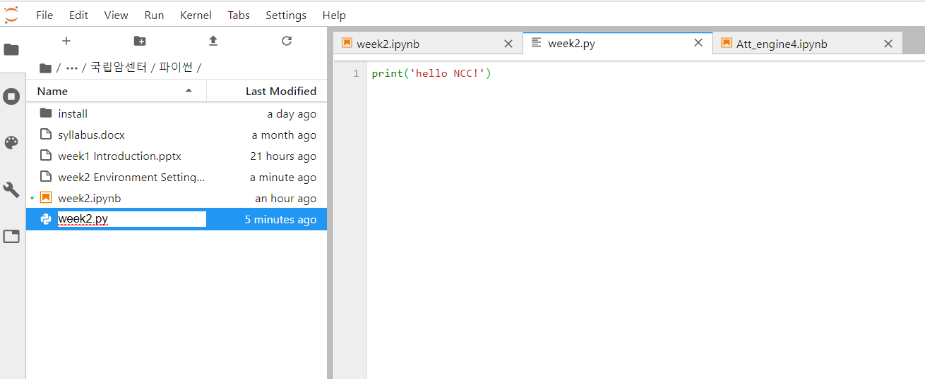
2. Installing Jupyter lab
(6) Introduction to Jupyter lab
Rename the file as ‘week2.py’

Slide 42
2. Installing Jupyter lab
(6) Introduction to Jupyter lab
Open Terminal (CMD window)

Slide 43
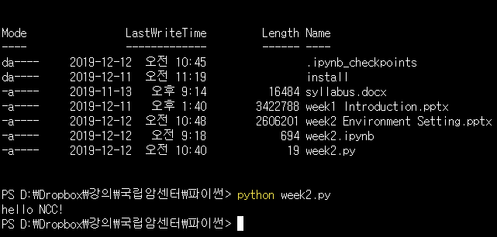
2. Installing Jupyter lab
(6) Introduction to Jupyter lab

